Slide 1

Blockchain based DApp for VANET
Guide:Prof.Umesh Bodkhe
-20BCE028 Kelvi Bavariya
-20BCE045 Dhruva Chopda

Slide 2
Agenda
Introduction of VANET
Security issues and Attack vectors in VANET
Why Blockchain?
Blockchain based decentralized application: Proposed system
Result: Performance and Security analysis
Future work
Conclusion
References

Slide 3
Introduction of VANET
VANET, or Vehicular Ad Hoc Network, is a specialized form of Mobile Ad Hoc Network (MANET) designed for communication among vehicles on the road.
It leverages the capabilities of wireless communication to enable vehicles to exchange information, enhancing road safety, traffic efficiency, and overall transportation systems.

Slide 4
Key Features:
- Dynamic Topology
- Vehicle-to-Vehicle (V2V) Communication
- Vehicle-to-Infrastructure (V2I) Communication
Applications:
- Collision Avoidance
- Traffic Management
- Emergency Services

Slide 5
Security issues and Attack vectors in VANET
Attack on privacy
Authentication and authorization
Attack on Data Integrity
DoS attack
Routing Attacks
Sensor and Hardware Attacks
Malware and Software Attacks
Trust Management

Slide 6
Why Blockchain?
Problems in Traditional Security Mechanisms | Solution as Block-chain
Centralized system:single point of failure | Decentralized System: control across a network of nodes
Data can be vulnerable to tampering or unauthorized alterations | Data is cryptographically secured in blocks
Centralized systems might lack transparency, and auditing can be challenging due to limited access to records. | Blockchain provides transparency by allowing all participants in the network to view the entire transaction history.
contracts and agreements often require intermediaries or legal processes for enforcement. | Smart contracts are self-executing contracts with the terms of the agreement directly written into code.
Trust is often placed in central authorities | No need for intermediaries. Trust is established through consensus mechanisms and cryptographic verification

Slide 7
Blockchain based decentralized application: Proposed system
System is made using following tools & technologies:
ReactJS - for frontend
Hardhat - for dapp
Metamask (sepolia test network) - for transaction
JSON file server - for data storage in file server

Slide 8
Phases of the system
Proposed system have 3 phases:
Registration Phase: In this phase, We register vehicle into network
Message dissemination phase: This phase is responsible for communication between registered vehicles.
Display chats phase: This phase display all chats information of given vehicle

Slide 9
Registration phase
The registerVehicle function allows customers to register their vehicles in the system by taking its details such as ID, coordinates (x and y), speed, acceleration, and heading.
This phase has some constraint like vehicle id can not be empty and registered vehicle can not register again.
if input satisfy all above requirements then it will add that vehicle in registeredVehicles array of smart contract and vehicles array of JSON file server

Slide 10
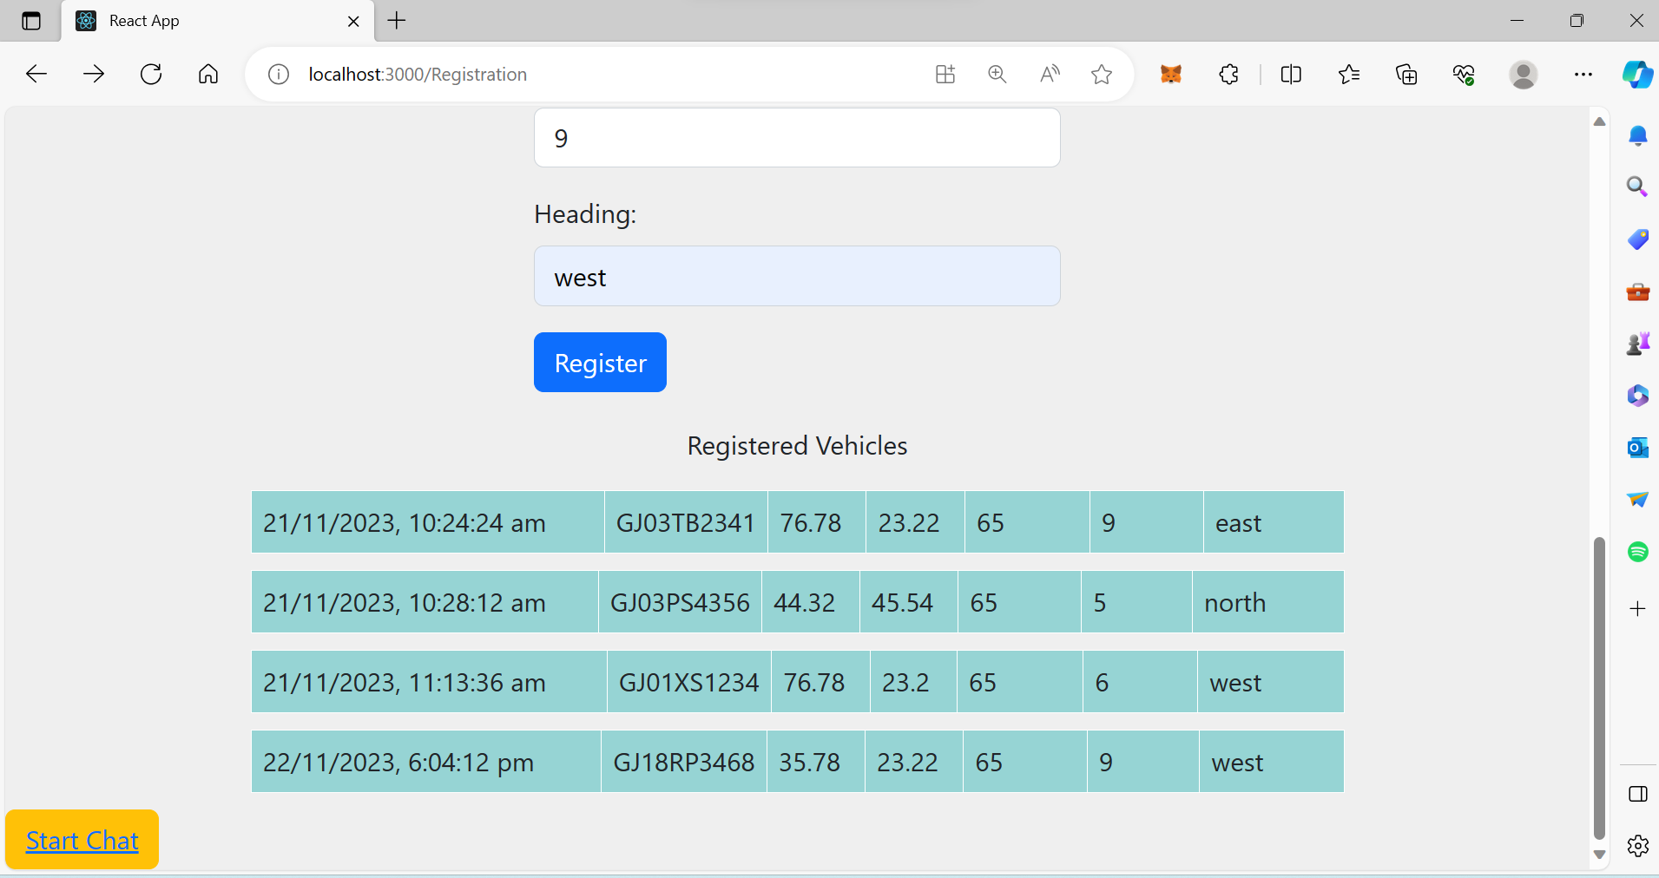

Slide 11
Message dissemination phase
The sendMessage function facilitates communication between registered vehicles.
We take sender's and recipient's information, along with the message content and geographical coordinates, if sender vehicle and recipient vehicle both are registered and different then it is stored in the memos array of smart contract and messages array of JSON file server.
Additionally, the message is added to the sentMessages of the sender and the receivedMessages of the recipient in smart contract.

Slide 12
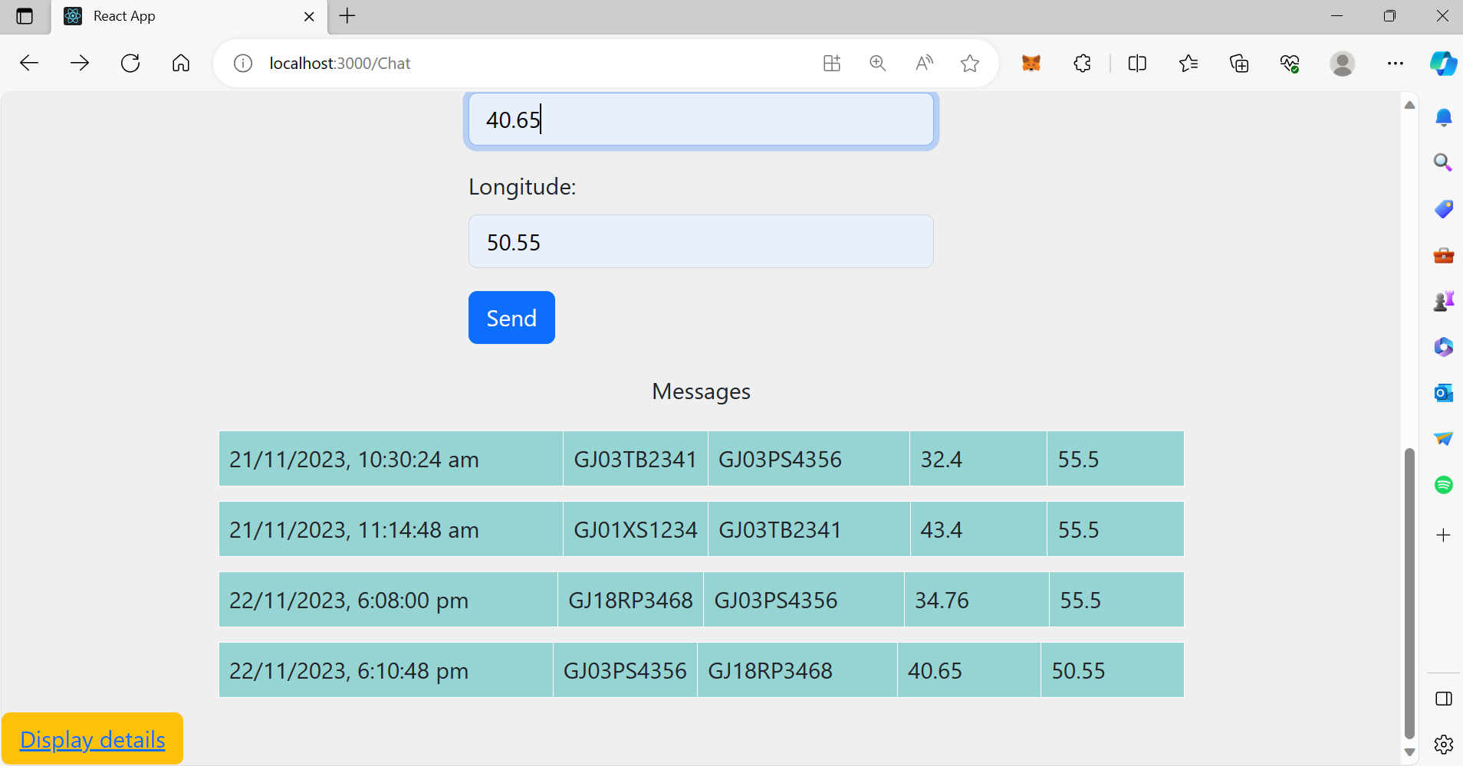

Slide 13
Display chat phase
This phase allows user to enter vehicle id and check their chatting history.
When user give vehicle id, smart contract will check if vehicle is registered then dapp will display all sent message which are send by this vehicle and all received messages that are received by this vehicle.
Send messages are fetched by sentMessages and received messages are fetched by receivedMessages.

Slide 14
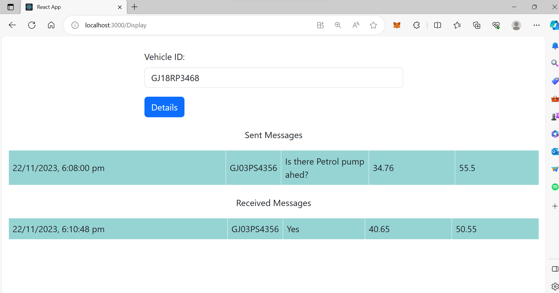

Slide 15
Result: Performance and Security analysis
The security issues we found before:
Reentrancy
Use of floating pragma
Compiler version too recent
Outdated compiler version
Missing events
Missing state variable visibility
Variables should be immutable
Name mapping parameters
Use call instead of transfer
Block values as a proxy for time
Define constructor as payable
Function should be External
Cheaper conditional operator
Long require/revert string
Strong variable caching in memory
From this we are able to remove following issues : Define constructor as payable ,Function should be External and Long require/revert string and achieved 70.59% of security from 44.44%.

Slide 16
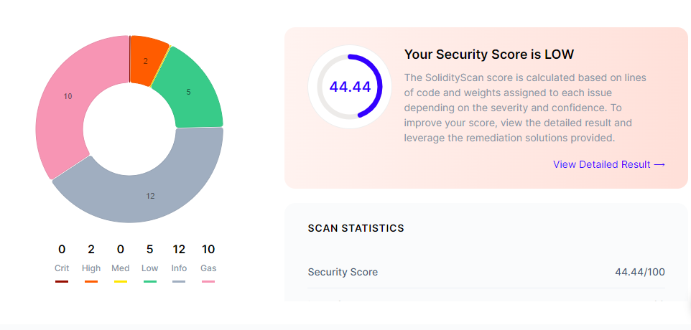
Result: Performance and Security analysis

Slide 17
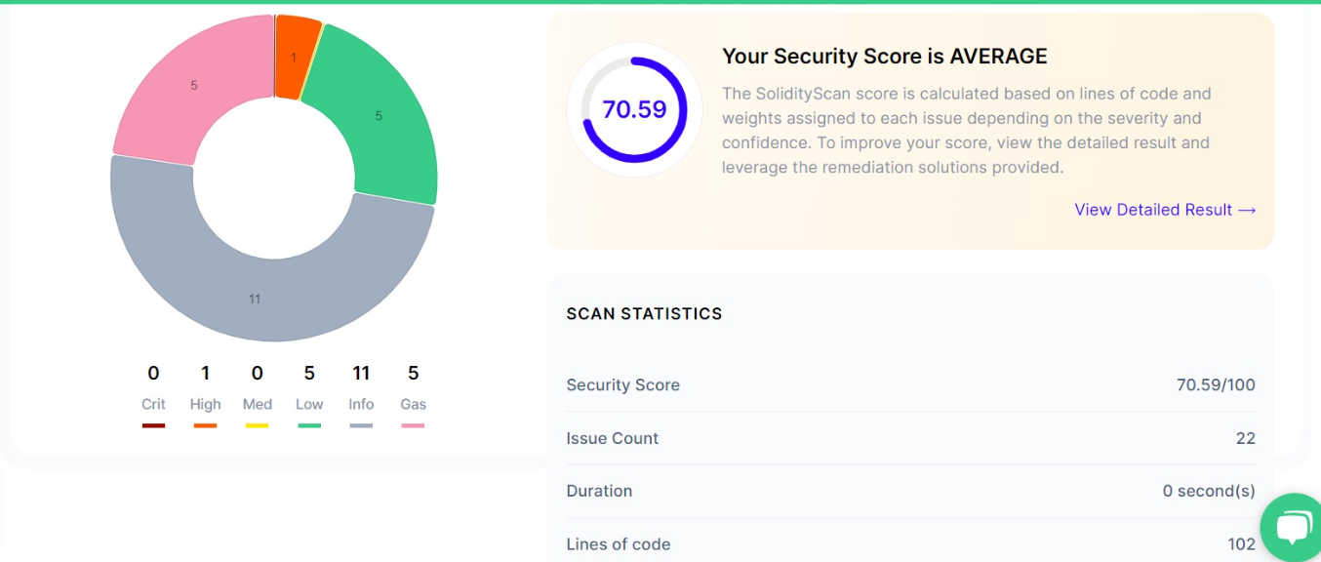
Result: Performance and Security analysis

Slide 18
Future work
We will try to make our smart contract more secure.
We will try to integrate our Dapp with google Maps and sumo simulator.

Slide 19
Conclusion
We have proposed Blockchain based Decentralized application for vehicular Ad-hoc Network , in which we have included registration , message and display chat phases by this application we have achieved security,decentralization of data,data transparency and auditability , immutability and trustless transactions.

Slide 20
References
Sumra, Irshad Ahmed, Iftikhar Ahmad, and Halabi Hasbullah. "Behavior of attacker and some new possible attacks in vehicular ad hoc network (VANET)." 2011 3rd international congress on ultra modern telecommunications and control systems and workshops (ICUMT). IEEE, 2011.
Al Junaid, Mohammed Ali Hezam, \textit{et al}. "Classification of security attacks in VANET: A review of requirements and perspectives." MATEC web of conferences. Vol. 150. EDP Sciences, 2018.
Khan, Abdullah Ayub, \textit{et al}. "Vehicle to everything (V2X) and edge computing: A secure lifecycle for UAV-assisted vehicle network and offloading with blockchain." Drones 6.12 (2022): 377.
Dahmani, Nadia, \textit{et al}. "Welcome Wagons: A Block Chain based Web Application for Car Booking." 2022 IEEE/ACS 19th International Conference on Computer Systems and Applications (AICCSA). IEEE, 2022.
Narayan, Sangeeta, \textit{et al}. "Blockchain and IPFS-based Data Storage for VANET." 2022 13th International Conference on Information and Communication Technology Convergence (ICTC). IEEE, 2022.
Feng, Hailin, Dongliang Chen, and Zhihan Lv. "Blockchain in digital twins-based vehicle management in VANETs." IEEE Transactions on Intelligent Transportation Systems 23.10 (2022): 19613-19623.

Slide 21
References
Mir, Farooq Ahmad, and Mohamad Tariq Banday. "Control of Spam: A Comparative Approach with special reference to India." Information & Communications Technology Law 19.1 (2010): 27-59.
Rehman, Sabih-Ur, et al. "Vehicular ad-hoc networks (VANETs): an overview and challenges." Journal of Wireless Networking and communications 3.3 (2013): 29-38.
Mohammad, Sajjad Akbar, Asim Rasheed, and Amir Qayyum. "VANET architectures and protocol stacks: a survey." Communication Technologies for Vehicles: Third International Workshop, Nets4Cars/Nets4Trains 2011, Oberpfaffenhofen, Germany, March 23-24, 2011. Proceedings 3. Springer Berlin Heidelberg, 2011.
Mishra, Rashmi, Akhilesh Singh, and Rakesh Kumar. "VANET security: Issues, challenges and solutions." 2016 international conference on electrical, electronics, and optimization techniques (ICEEOT). IEEE, 2016.
Sharma, Sparsh, et al. "A detailed tutorial survey on VANETs: Emerging architectures, applications, security issues, and solutions." International Journal of Communication Systems 34.14 (2021): e4905.
Inedjaren, Youssef, et al. "Blockchain-based distributed management system for trust in VANET." Vehicular Communications 30 (2021): 100350.
Ma, Zhuo, et al. "An efficient decentralized key management mechanism for VANET with blockchain." IEEE Transactions on Vehicular Technology 69.6 (2020): 5836-5849.
Nema, Megha et al. “Analysis of Attacks and Challenges in VANET.” (2014).

Slide 22
Thank you.

